Slide 1
English Writing II
Week 9 OED Sample reading

Slide 2
In today’s lesson
Discussion of the topics
OED special update
In-class reading and sample analysis
In-class writing

Slide 3

What changes did the pandemic bring to our lives?
Booming online teaching platforms and APPs
The rise of home theatre
A boom in take-out food
Hoarding of food and daily necessities
Saving instead of consuming
Social distancing in public places

Slide 4
What changes did the pandemic bring to our lives?
? Social relief for low-income and vulnerable groups
? Paying more attention to our health
? Strict regulation of the wet markets
? New understanding of staying at home
? Abandon some traditional customs

Slide 5
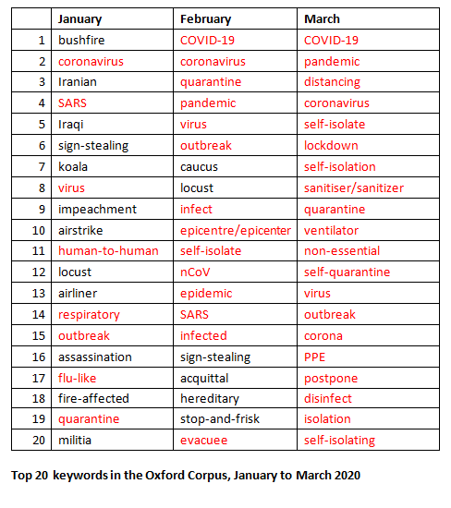
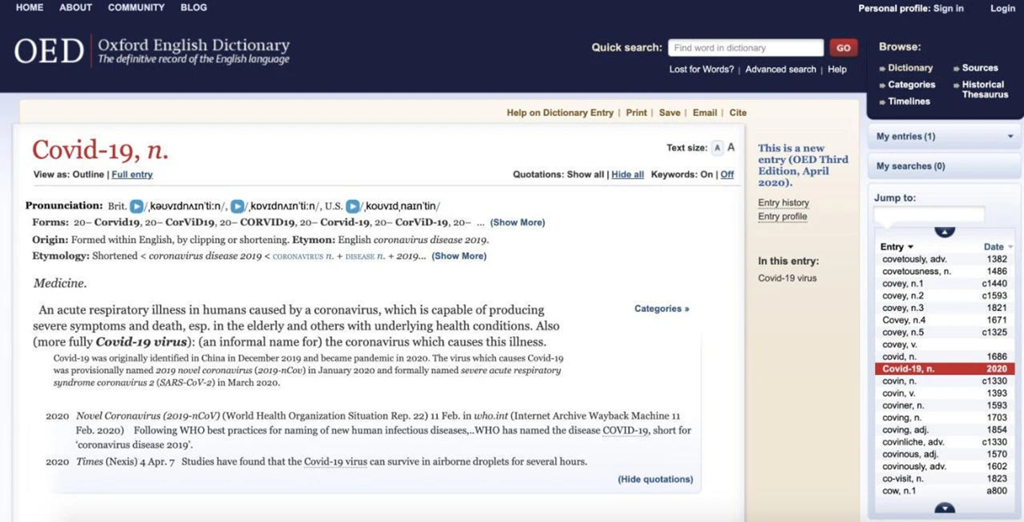
OED new words

Slide 6
OED hot words
Covid-19
Infodemic
self-isolation
self-quarantine
social distancing
Work from home (WFH)
PPE
Non-essential
Ventilator
shelter in place

Slide 7
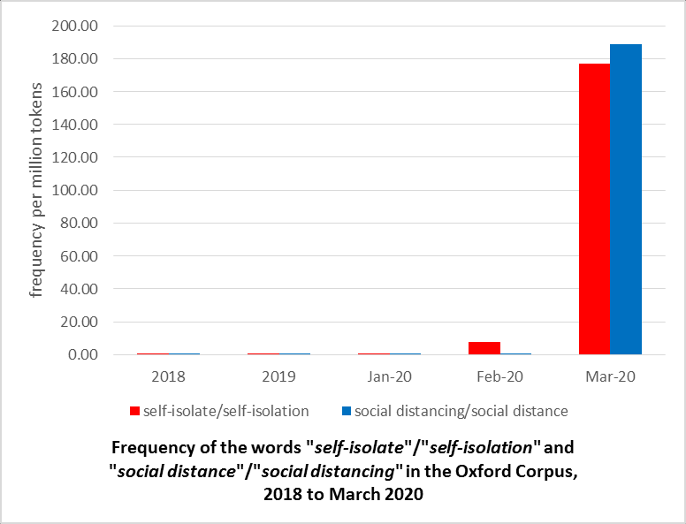

Slide 8
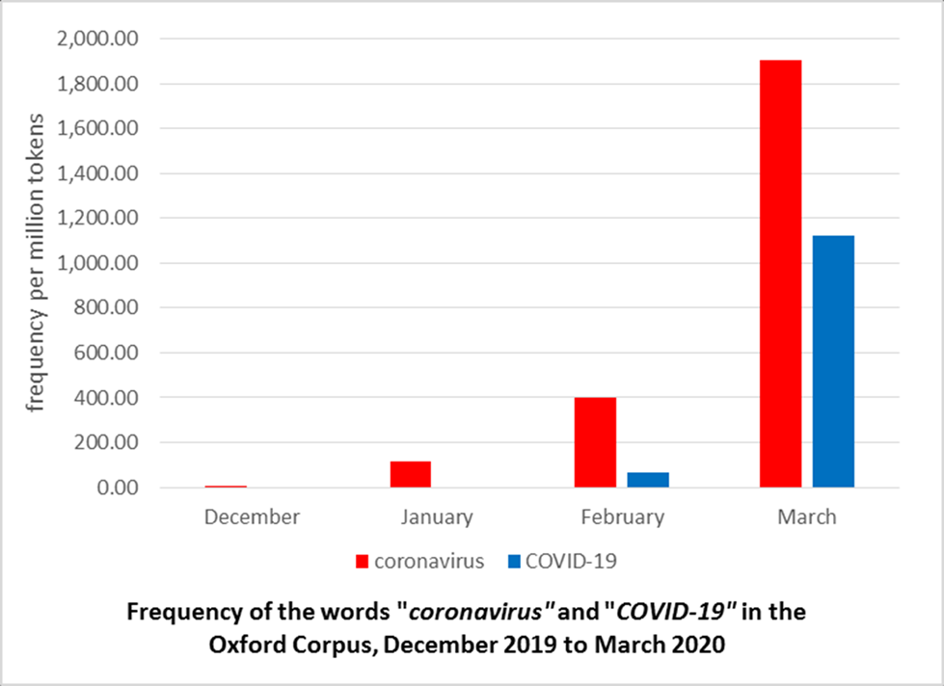

Slide 9

In-class reading (15 minutes)
Social Change and Linguistic Change: The language of Covid-19

Slide 10
Close-up reading: the structure
Statement of the focus
Background information of the special update
Significant terms during the pandemic
Historical review of the pandemic-related terms
Restatement of the OED mission

Slide 11
Statement and restatement of the focus
Opening paragraph: It is a consistent theme of lexicography that great social change brings great linguistic change, and that has never been truer than in this current global crisis.”
Closing paragraph: The OED will keep updating its coverage to help tell the story of these times that will inevitably become embedded in our language.

Slide 12
Merits of the article (1144 words)
A professional perspective – lexicographer’s view
A clear and powerful focus
Rich and specific examples and explanations
A historical review to add weight to the focus
Note: largely expository

Slide 13
Useful words and expressions
An exponential rise in …
Ushered in a new vocabulary to the general populace
The linguistic and social context
Government briefing sand edicts
Unsubstantiated media and online information

Slide 14
Useful words and expressions
Proliferation of news around coronavirus
To grabble (linguistically) with the epidemics they witnessed and experienced
Virulently contagious diseases
Open the floodgate

Slide 15

After-class sample reading
Why Do Balconies Inspire Us? (BBC)

Slide 16
In-class writing 901: An outline
Perspective: personal life, economy, education, etc.
Focus: What is it?
Examples or supporting evidence (2-3)
Extended explanation or discussion (the “weight”)
Submission before the weekend

